Slide 1
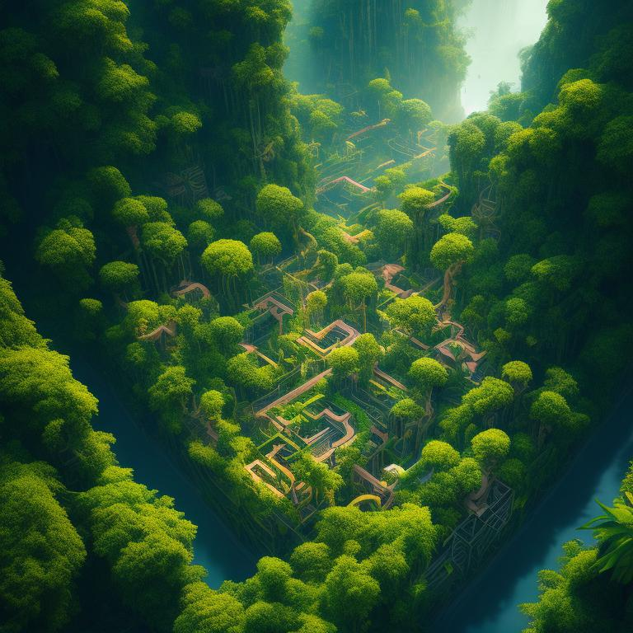
THE
JUNGLE
MAZE
RUNTIME TERRORS
Game Concept
"Jungle Maze" is an adventure game where the player takes on the role of Tenali Rama, a clever and witty character from Indian folklore. The game is set in a jungle where King Krishnadevaraya has been kidnapped, and it's up to the player to navigate through a series of maze-like levels to rescue the king.

Slide 2
THE
JUNGLE
MAZE
RUNTIME TERRORS
Game Concept
"Jungle Maze" is an adventure game where the player takes on the role of Tenali Rama, a clever and witty character from Indian folklore. The game is set in a jungle where King Krishnadevaraya has been kidnapped, and it's up to the player to navigate through a series of maze-like levels to rescue the king.

Slide 3

Resources
We utilized Python as the programming language for game development, along with the Pygame library
We used PyCharm as the Integrated Development Environment (IDE) for coding and managing our Python projects.
We utilized photo editing software or online platforms to create and edit graphics, sprites, backgrounds, and other visual elements used in the game

Slide 4
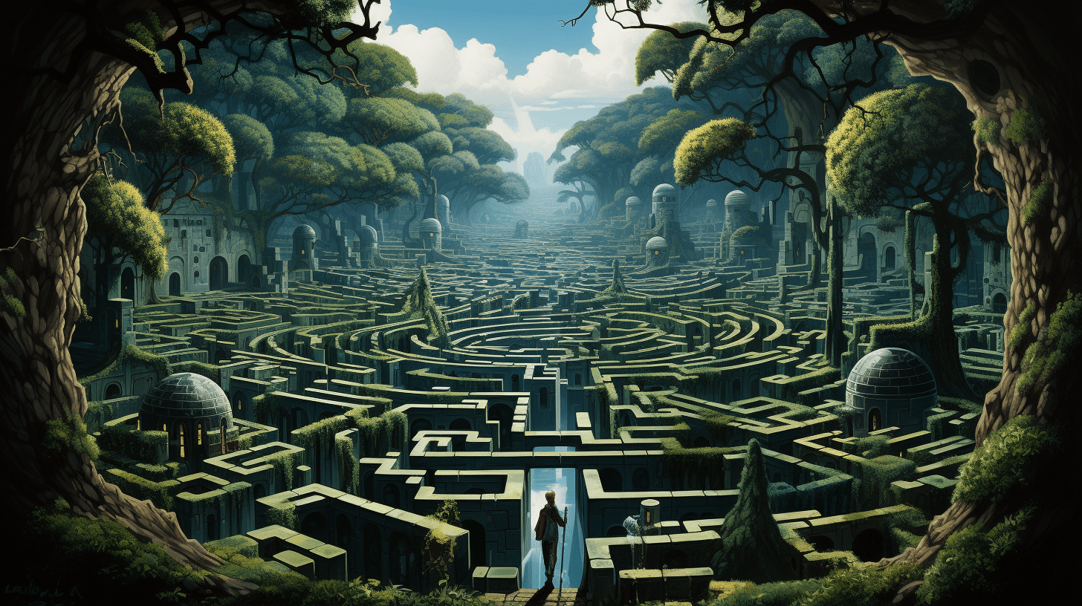
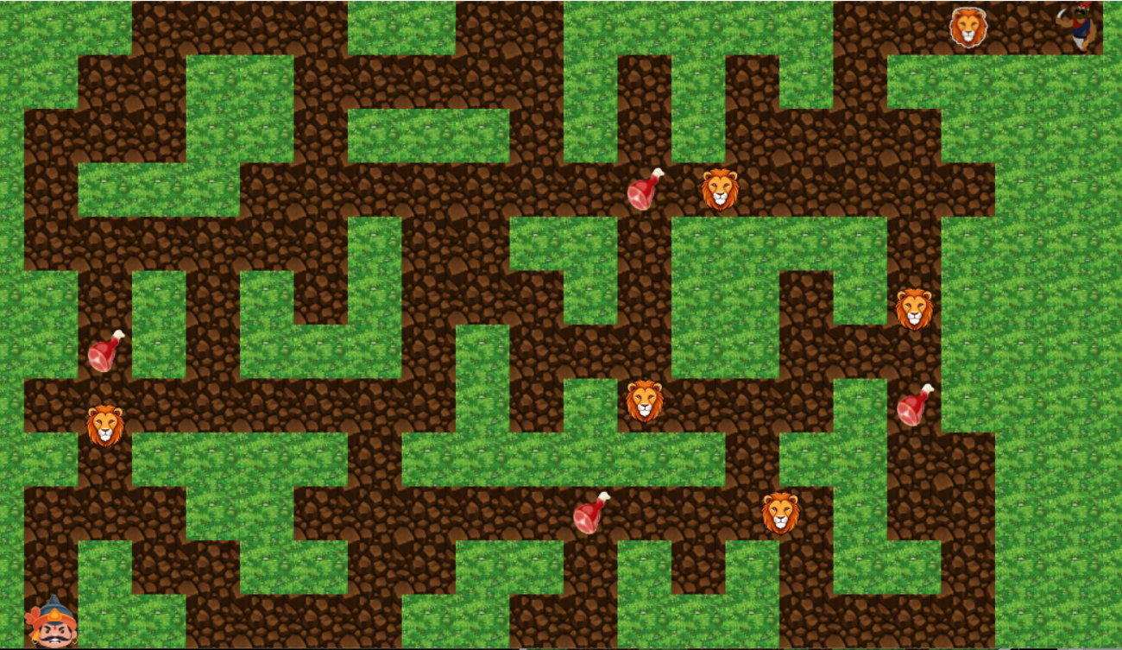
Gameplay Overview
The core gameplay involves collecting specific items while avoiding or pacifying dangerous animals that guard exits. Each level presents different environments, such as jungles, rivers, and arctic regions, with corresponding obstacles like wild animals. Players must strategize to gather items and progress while overcoming environmental hazards and puzzles.

Slide 5
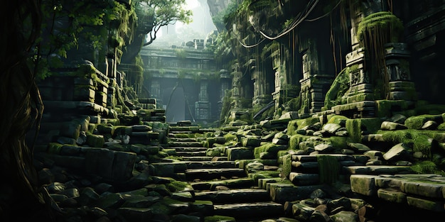
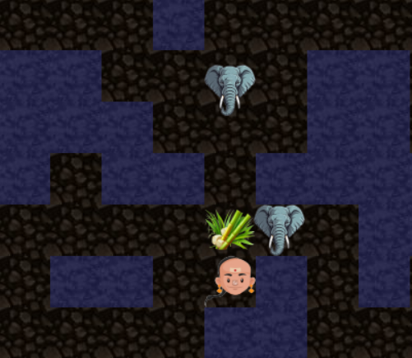
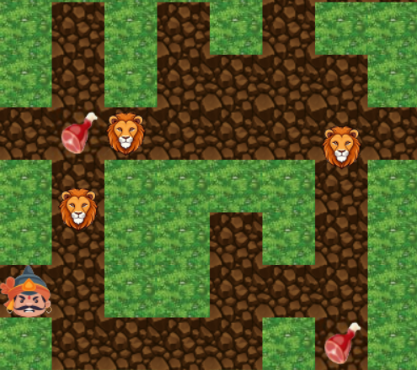
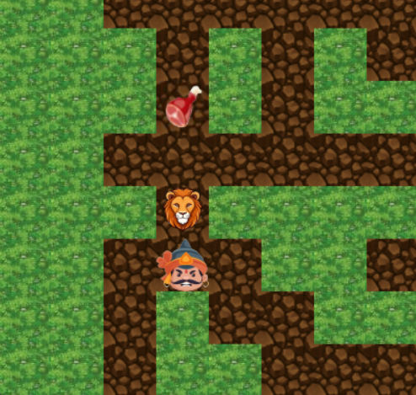
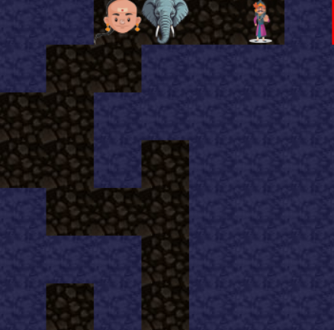
Navigating the Maze
Collect specific items
Animals move with different speeds
Avoid collision with animals
Reach exit point

Slide 6

Future Aspects
We can expand the storyline by introducing new challenges, characters, and plot twists.
We can consider updating the graphics with higher resolution textures, detailed character animations, dynamic lighting effects, and immersive soundtracks and sound effects.
To reach a wider audience, we plan to optimize the game for mobile devices, making it accessible to players on smartphones and tablets.

Slide 7
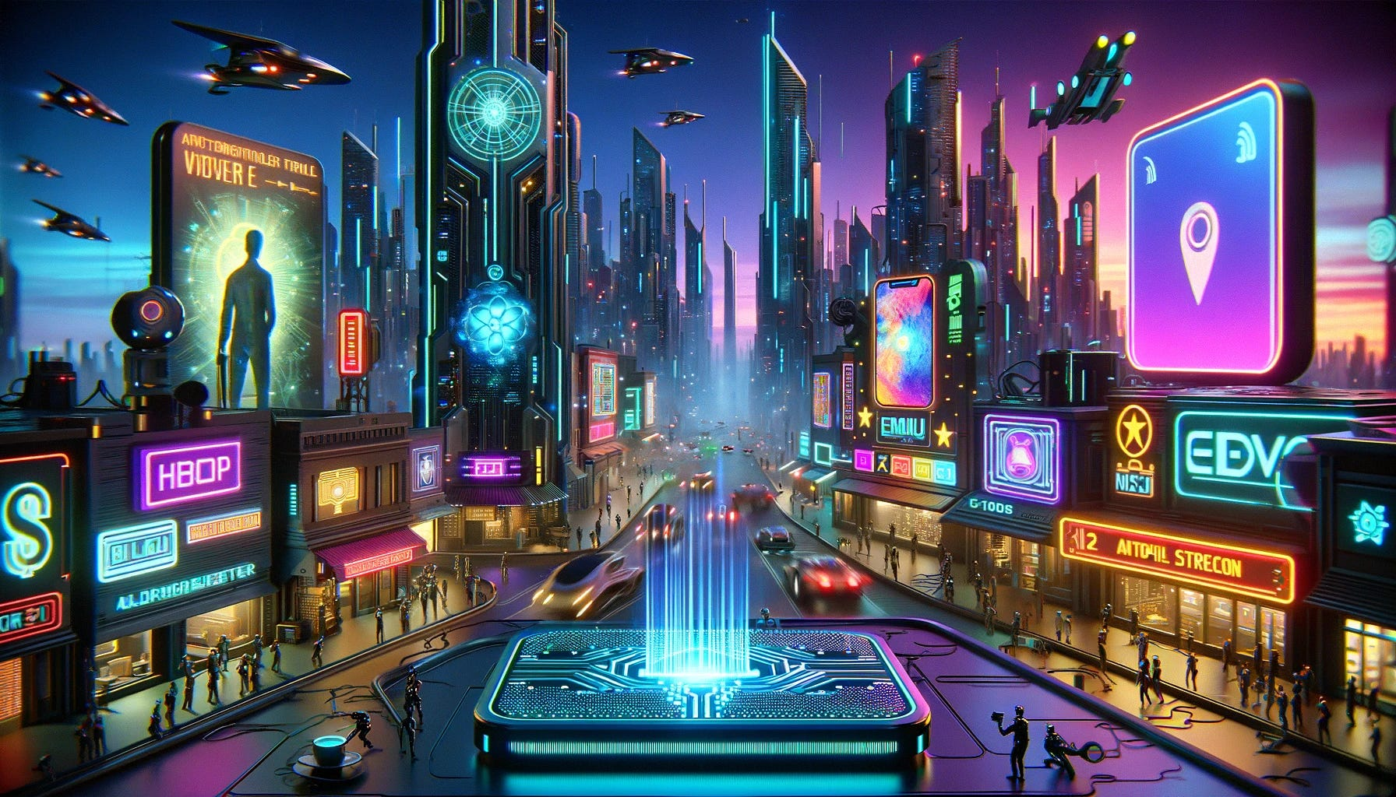
Conclusion
"The Jungle Maze" delivers an exciting and challenging adventure through diverse environments, engaging players with strategic puzzles and captivating storylines. With immersive atmosphere, sound design, and intuitive controls, the game offers a memorable and enjoyable gaming experience.

Slide 8
THANK
YOU
Game Concept
“The Jungle Maze" is an exciting and educational maze-solving game to be designed for kids. Players take on the role of a brave adventurer who finds themselves trapped in a jungle maze filled with wild animals. The objective is to navigate through the maze, collect keys to unlock the exit door, and escape without getting caught by the roaming wildlife.

